Slide 1
Plan Formulation for Deep Draft Harbors
Planning and Formulation Considerations

Slide 2
Topics to be Discussed
Plan Formulation Function for Deep Draft Navigation
Federal Interest
Basic Concepts
Problem Identification
Inventory and Forecast
Determination of Objectives and Constraints

Slide 3
Plan Formulation
Lead planning process
Identify problems
Set planning objectives
Define existing condition
Define future with and without project conditions
Develop alternatives
Conduct trade off analysis
Apply cost sharing requirements
Technical Integration
Prepare Feasibility Report
Facilitate review process and issue resolution

Slide 4
Federal Interest
“The role of the U. S. Army Corps of Engineers with respect to navigation is to provide safe, reliable, and efficient waterborne transportation systems (channels, harbors, and waterways) for movement of commerce, national security needs, and recreation. The Corps accomplishes this mission through a combination of capital improvements and the operation and maintenance of existing projects.”
-ER 1105-2-100
Notes:
The Commerce Clause is in Article One, Section Eight of the U.S. Constitution. It states, “The Congress shall have Power … To regulate Commerce with foreign Nations, and among the several States and with the Indian tribes;
Federal Interest is the basis for Federal participation in water resource projects including cost sharing and other project responsibilities. It determines how and where the government can spend taxpayer money. The Federal role also determines whether the local or Federal partner pays for various items. The economist’s NED evaluation is independent of cost-sharing requirements. Verification of the Federal Interest in a project is a prerequisite to project implementation. Study reports must have a conclusive statement of why such interest does or does not exist. Federal Interest in a project depends upon whether it provides benefits to the nation by facilitating commerce. This requires identification of opportunities, constraints, public purpose and access, and the commerce served.
In addition the Federal Interest pre-requisite, there are several other important considerations to keep in mind:
• Project Components: Federal participation in project components is limited to general navigation features such as channels, basins, protective works, and aids to navigation such as buoys and lights. The Corps is responsible for general navigation features whereas the U.S. Coast Guard is responsible for aids to navigation. This distinction is particularly important when defining cost sharing.
• Public Purpose: The fundamental public purpose of a navigation project is to facilitate the movement of vessels and the transportation of passengers and cargo. Public purpose requires that there be multiple users and project beneficiaries, or an expectation of multiple usages in
the future.
• Public Access: In addition, Federal projects must be open to public use for the projects’ purposes. For navigation projects, the access required is at least one location with the vessel or cargo service facilities needed to achieve project benefits open to all users on equal terms.

Slide 5
Basic Concepts
Deep-Draft Navigation
Harbor and port systems and their hinterlands
General navigation features
Types of deep draft vessels
Basic vessel characteristics
Channel characteristics

Slide 6
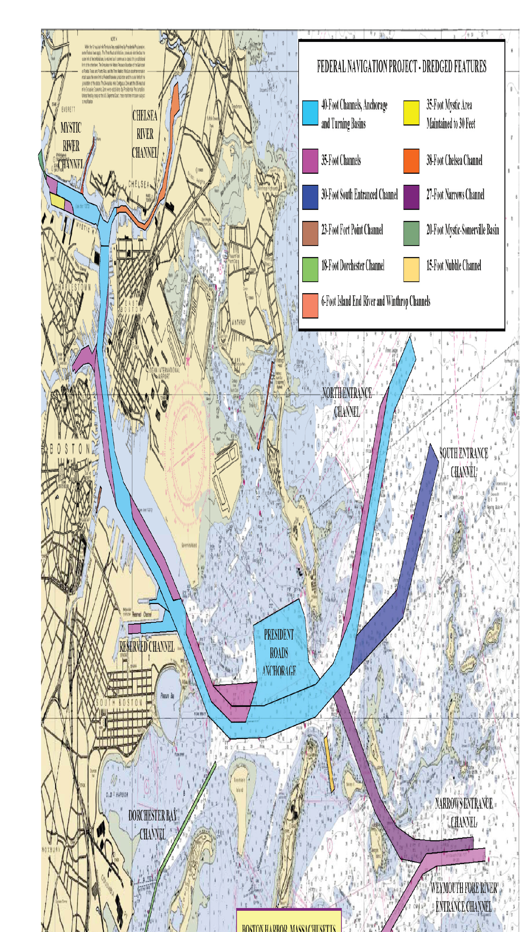
Boston Harbor, Massachusetts
Notes:
A harbor is a sheltered part of a body of water deep enough to provide anchorage for ships or a place of refuge. A port is a place by a waterway where
ships and boats can dock, load and unload. Together they form the planning setting for the prospective project and are most commonly referred to as ports. No two ports are the same. Specialty ports and harbors are easier to understand and document because the focus is specific in terms of cargoes and fleets. General purpose harbors can be much more complex because they host a variety of cargoes and fleets that may or may not be affected by improvements.

Slide 7
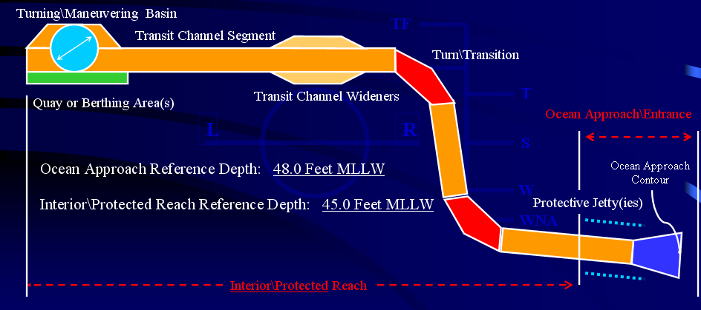
Harbors and Ports
Notes:
As a matter of law and policy, a distinction is made between general navigation features, and other features or facilities serving navigation. The Corps participates financially in general navigation features and Special Navigation Programs only (see below); all other features and
Facilities, referred to as Local Service Facilities (e.g., piers) are non-Federal responsibilities.
General navigation features include channels, jetties or breakwaters; locks and dams; basins or water areas for vessel maneuvering, turning, passing, mooring or anchoring incidental to transit of the channels and locks. The also include dredged material disposal areas (since WRDA 96) sediment basins and aids to navigation. These are eligible for development as general navigation features of harbor or waterway projects.
Typical Project Elements (EM 1110-2-1613, Hydraulic Design of Deep Draft Navigation Projects). Figure 2-1 presents an example generic harbor defining many of the typical project elements discussed below. The following project features are normally the responsibility of the Corps:
a. Entrance channel. A navigable channel connecting the ocean or lake to an enclosed water body such as a bay, estuary, river, or mouth of a navigable stream.
b. Jetties. Structural features that provide obstructions to littoral drift, control entrance currents, prevent or reduce shoaling in the entrance channel, maintain channel alignment, and provide protection from waves for navigation.
c. Breakwaters. Structures designed to provide shelter from waves and improve navigation conditions. Such structures may be combined with jetties where required (EM 1110-2-2904).
d. Interior channel. The access channel system inside a water body that connects the entrance channel (inlet or bar) to a port or harbor with appropriate ship facilities. Interior channels are usually located to provide some protection from waves and weather and are located in bays, estuaries, or rivers.
e. Turning basin. An area that provides for the turning of a ship (bow to stern). Turning basins are usually located at or near the upper end of the interior channel and possibly at one or more intermediate points along long channels.
f. Anchorage area. An area inside a water body providing the ships some protection from the weather while lying at anchor to stand by, load or unload cargo, await repairs, etc.
g. Special features. Specifically designed structural elements that provide for special project design requirements, such as salinity control barriers, ship locks, ice control booms, bridge pier protection (fendering systems), hurricane barriers, sediment traps, and other similar control works.
h. Advanced maintenance features -

Slide 8
Hinterlands
Notes:
The inland trade region served by a port is called its hinterland. That hinterland usually consists of a number of cargo hinterlands defined by the inland origins or destinations of specific commodities. The port hinterland is also known as the “economic study area.” The economic study area is a collection of cargo hinterlands and is also known as the port hinterland. Cargo hinterlands are defined by the actual and potential inland origins and destinations for a given commodity and project port . Port traffic and project benefits will depend on the commerce of the region and the degree to which other ports share in this commerce. For NED analysis, the economist is interested in the port cargo hinterlands defined by the vessels and their cargoes to be benefited by the project.
Port hinterlands can be broadly classified as captive or competitive:
• Captive cargo hinterlands will use the study port exclusively for either origin or destination
• Competitive cargo hinterlands are those where there is a choice between ports for the origin or destination of the cargo, making a multiport analysis necessary.
For example, the Tampa Port Authority’s Master Plan determined that the Port of Tampa’s competitive hinterland for containerized cargo consists of 24
counties in West Central Florida that received and shipped 336,000 containers in 2005

Slide 9
Hinterlands
(continued)
Notes:
Multiport Analysis is recommended at some scale for all studies. Multiport analyses are typically unnecessary for captive commodity ports or ports
that are so far away from any nearby competition with no good relationship between the two ports, such as 400 plus miles away.

Slide 10
Break Bulk Vessel
Notes:
Breakbulk vessels are among the world’s oldest types of vessels. They carry bulk and odd-sized cargo that is often stored in bags and placed onto pallets. The vessels are compartmentalized with several "holds" for stowing cargo. Cranes on the ship lift the cargo from alongside the ship into and out of the holds. Breakbulk vessels represent a declining share of the world fleet and are used mainly at ports that do not have significant facilities for containers.

Slide 11
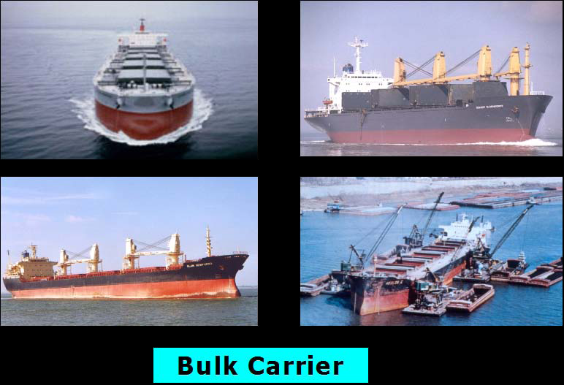
Notes:
Bulk carriers, also known as bulkers or bulk freighters, carry bulk commodities such as petroleum, grain, coal, cement, or ore, which are not packaged and transported in cargo holds which are storage containers. Generally bulk carriers require crews to move much of the cargo (vs. cranes or other equipment) which makes these vessels sometimes a bit risky for crewman and time consuming.

Slide 12
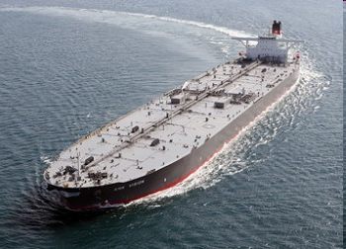
Tanker
Notes:
Tankers are some of the world’s largest propelled ships. A tanker is a ship that is specially designed to carry liquids such as oil, ammonia, or liquefied natural gas. Consequently, these vessels are increasingly being built with safety features such as containing double-hulls (2 skins). As of 2005, the United States Maritime Administration reported 4,024 tankers of 10,000 DWT or greater worldwide; 2,582 of these are double-hulled. 7. There are two general categories of tankers: crude and product. Crude carriers tend to be larger and carry unrefined products. So-called supertankers, which exceed 200,000 DWT, are employed to transport crude petroleum from the oil fields to refineries. These ships often have some of the deepest drafts when they are carrying products. The largest tanker vessel, Ultra Large Crude Carriers’ (ULCCs) drafts can approach 100 feet (30.5 meters) which means that it cannot
enter any major world port. Smaller shuttle tankers are also used to transport oil from off-shore to inland; the trend through the 2000s for these vessels is to become large. Product carriers tend to be smaller, trekking smaller distances, and carrying more petrochemical, such as gasoline, kerosene and lubricating oils. While historically these product vessels were generally less than 30,000 DWT, there is a trend towards making product tankers larger and having more than 25 percent of the fleet being larger than 30,000 DWT.

Slide 13
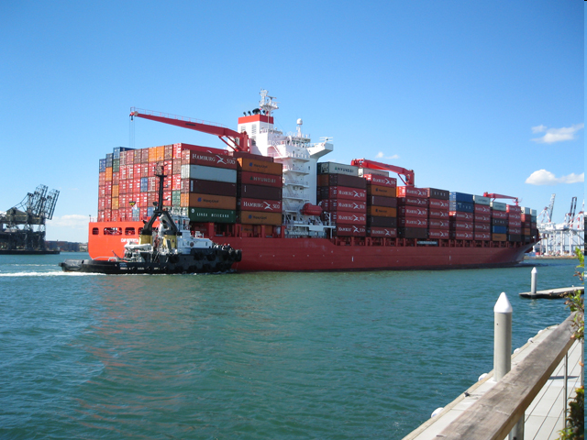
Containership
Notes:
Containerships, also known as “box ships" or "box boats” are specifically outfitted to carry containerized cargo, such as cargo stored in aluminum boxes. The containers carry various types of cargo and can be used on semi-trucks chassis, rail cars, or stacked on ships. Containers are typically measured by twenty-foot equivalent units or TEUs, although many boxes are increasingly measured by forty-foot equivalent units (FEUs). Containerships carry the majority of the world's finished goods and have been in existence since the 1950’s. Common goods that Americans are familiar with are tennis shoes, lamps, clothes and other household items that are typically imported, shipped to retail distribution centers, and then to a retail store.

Slide 14
Roll On/Roll Off Vessels
Notes:
Roll-On/Roll-Off [RO/RO] vessels are specifically designed to carry wheeled and tracked vehicles, mostly cars. The vehicles are driven or towed on and off the ship along ramps that are built into each vessel. According to the Journal of Commerce, in 2008 the Port of New York/New Jersey was the busiest vehicle handling port in the US, followed by the Port of Jacksonville.

Slide 15
Liquefied Natural Gas Tanker
Notes:
Liquefied natural gas (LNG) is natural gas that has been cooled to the point that it condenses to a liquid. Liquefaction reduces the volume by approximately 600 times, making it economical to ship. LNG is shipped throughout the world in specially constructed seagoing vessels. Because of safety reasons, LNG terminals are often located furthest from population centers and require a safety zone while transiting. A safety zone is a designated buffer area in which no moving vessel can come within a certain distance.

Slide 16
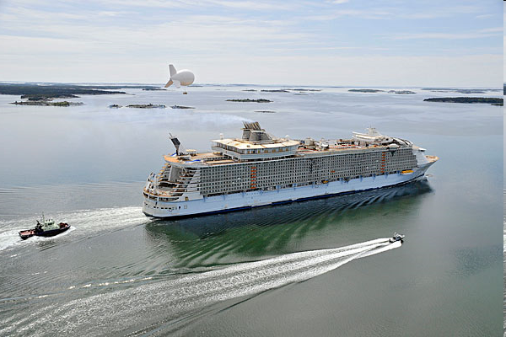
Cruise Ships
Notes:
In response to the growing cruise industry, cruise vessels have been increasing in size and providing more on-board amenities such as rock climbing, gyms, casinos and huge theaters. Some of the 2007 vessels, such as the Royal Caribbean International Genesis Class, weigh 220,000 tons, have a beam in excess of 154 feet, a length of nearly 1,200 feet, and can accommodate 5,400 or more passengers.

Slide 17
Vessel Characteristics
Type of Vessel: container, general cargo, tankers, etc.
Length Overall (LOA)
Beam Width
Draft
Height
Deadweight: weight of vessel
TPI (Tons per inch) immersion
Design Draft of Vessel
Gross Registered Tonnage: internal vessel capacity
Speed (at sea and at port)
Fuel Type and Consumption
Notes:
Deadweight Tonnage (dwt) - The rated carrying capacity of ships in tons. The capacity will vary with actual ship draft. The total weight of cargo, stores, crew, fuel, fresh water, etc., which a ship can carry. The difference between the loaded and light displacement tonnages. Usually given in metric tons today, but also rated in long tons for older vessels.
Design Draft – greatest allowable draft.
Gross Registered Tonnage (GRT) Gross Registered Tons. Internal cubic capacity of the ship expressed in tons on the basis of 100 cubic feet per ton. This differs from DWT because it measures the area versus the weight, same as gross tonnage.
Vessel Speeds
The published Corps vessel operating costs show "representative" speeds for major ship types. They can be used to simplify cost calculations, even though individual actual speeds may be a few knots faster or slower. Speeds vary depending on conditions, as a result, sea time and transportation
costs will be understated if actual or representative speeds are applied to the most direct port-to-port distances. The simplest solution is to inflate the travel distance by assuming some voyage circuitry.

Slide 18
Topics to be Discussed
Basic Concepts
Problem Identification
Inventory and Forecast
Determination of Objectives and Constraints
Notes:
Step One: "Specification of the water and related land resources problems and opportunities (relevant to the planning setting) associated with the Federal objective and State and local concerns." (P&G Standards, Section III paragraph 1.3.2 (a)(1))
Problem definition is the detailed description of a problem. It begins with a problem statement; a simple, usually one sentence, assertion of what the basic problem is. Problem definition can be expanded to identify the nature, cause, location, dimensions, origin, time frame, and importance of the problem, as well as an indication of who considers this a problem. An opportunity can be defined the same way.
Problems and opportunities statements will encompass current as well as future conditions and are dynamic in nature. Thus, they can be, and usually are, re-evaluated and modified in subsequent steps and iterations of the planning process. Plans are formulated to achieve planning objectives. Planning objectives and constraints are inexorably linked to problems and opportunities. Thus, clearly articulated problem and opportunity statements are essential to the success of any planning process.

Slide 19
Development of Problem Statements
May not be the same for all stakeholders
Sort out real versus perceived problems
For current and future
Problem statement should include:
  full description (e.g., answers who, what, where, when, why, how)
  Who considers it’s a problem
Notes:
In most water resource projects, the perception of problems and potential solutions may not be the same for all stakeholders. While this dilemma is minimal in deep-draft navigation, nonetheless, the problem for planners is to sort out real versus perceived problems and needs which we call opportunities. This has to be done for the current situation and has to be projected into the future. The initial identification of problems and opportunities may be modified during the subsequent planning process especially if baseline information does not support the problems and opportunities. The initial identification process relies on extreme examples of problems (usually associated with existing port commerce) or opportunities (usually commerce the port would like to attract).

Slide 20
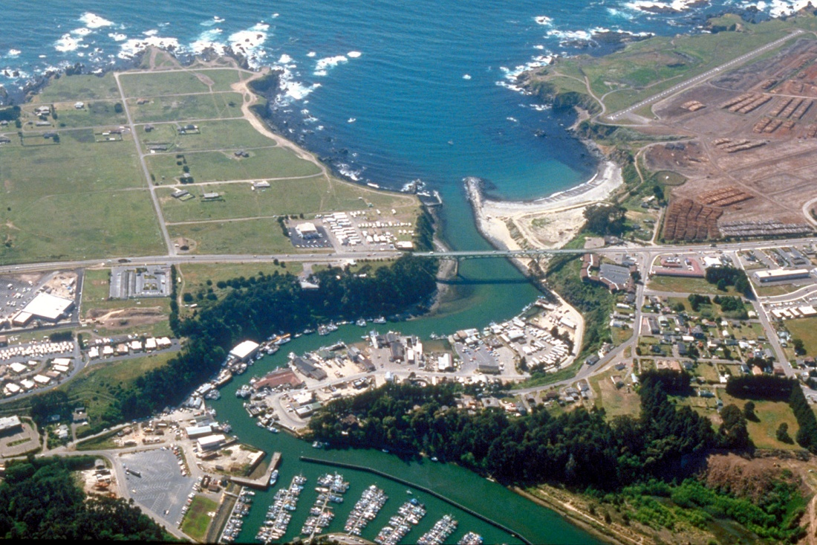
Symptoms of Problems
Physical Condition
Traffic Delays
Light Loading
Lightering
Safety Issues
Notes:
The symptoms of deep-draft navigation problems are manifested in the physical condition of the channels, disposal areas and locks; the practice of light loading or lightering; and the existence of traffic delays or use of tugs. In some cases excessive or increasing lockage times could be a symptom of a problem. Safety is often a buzz word folks will throw out to casually. Pilots will not operate in an unsafe manner, they have no incentive to do so. The will employ practices that add cost and time in order to operate safely.

Slide 21
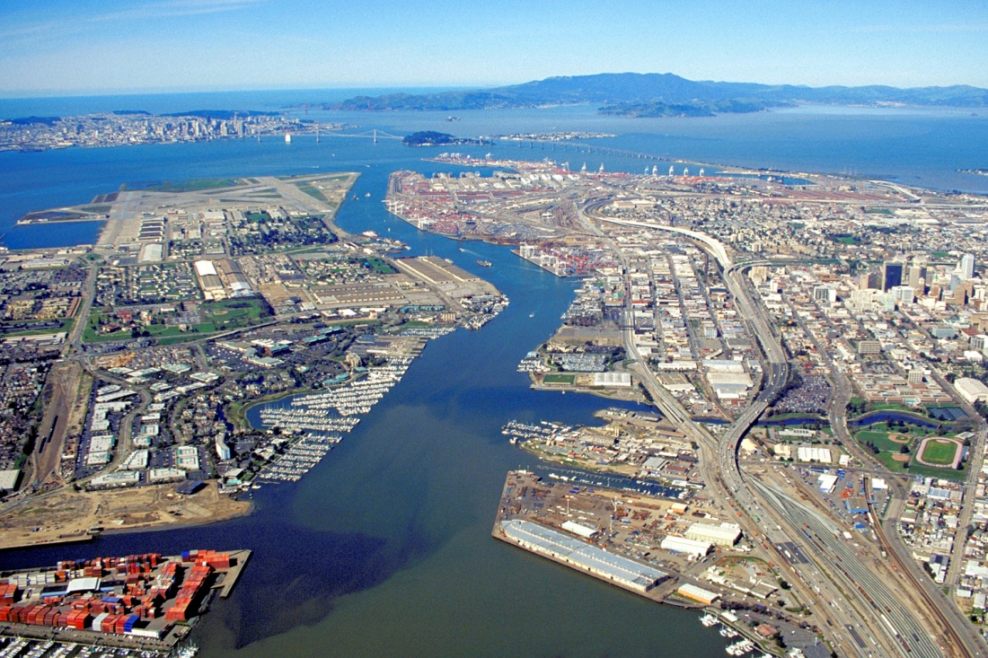
Problems May Arise From Channel Configurations
Depth/width
Turning Areas
Shoaling
Location
  Bends
  Currents
Notes:
With increasing ship sizes, the channel is usually too shallow and narrow to accommodate two-way traffic involving the most modern ships. Less likely, are problems involving channel locations, bends, currents and shoaling. These problems are universal to navigation and have been dealt with for decades in pretty much a prescribed formula. However, the accompanying problem is disposal of dredged material. This issue is playing an increasingly greater role in plan formulation, especially during reformulation.

Slide 22
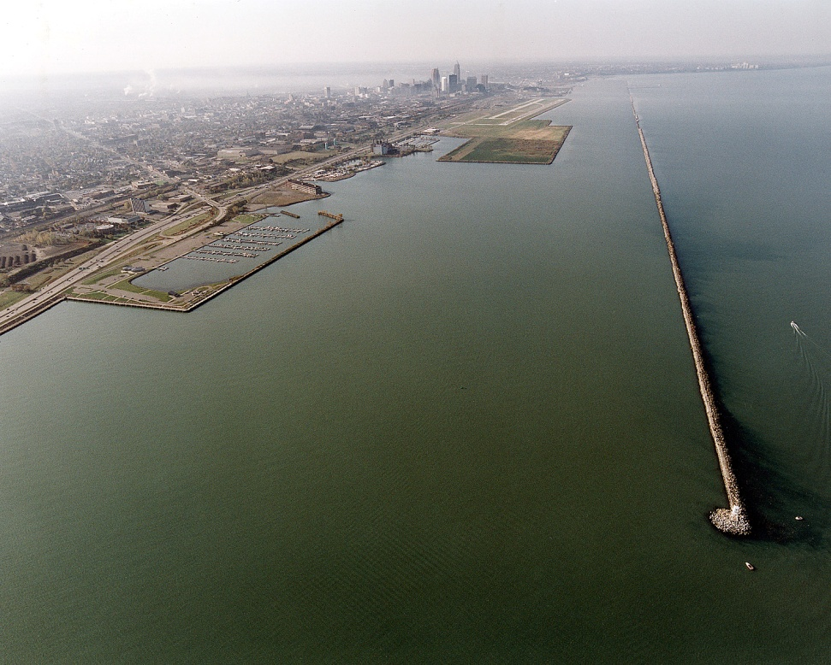
Dredged Material Disposal Problems
Capacity
Cost
Environmental Concerns
Notes:
The usual problems associated with disposal of dredged material are capacity and cost. Finding acceptable locations, with sufficient capacity for 50 years, that are environmentally acceptable is becoming increasingly challenging to the planning process. In addition it increases the stakeholder interests. PGL-47 issued xx xxx xx has helped deal with some of the expense issue as it allows the Corps to cost share disposal area construction expense w/ the local sponsor.

Slide 23
Topics to be Discussed
Basic Concepts
Problem Identification
Inventory and Forecast
Determination of Objectives and Constraints
Notes:
ER 1105-2-100: The second step of the planning process is to develop an inventory and forecast of critical resources (physical, demographic, economic, social, etc.) relevant to the problems and opportunities under consideration in the planning area. The forecast of the future without-project condition reflects the conditions expected during the period of analysis. The future without-project condition provides the basis from which alternative plans are formulated and impacts are assessed. Gathering information about historic and existing conditions requires an inventory. Gathering information about potential future conditions requires forecasts, which should be made for selected years over the period of analysis to indicate how changes in economic and other conditions are likely to have an impact on problems and opportunities.

Slide 24
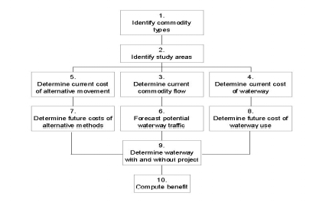
Deep Draft Navigation Benefit Evaluation Procedure
Notes:
This procedure is spelled out in greater detail in ER 1105-2-100 and it is not important that the plan formulator be an expert in this procedure, but the formulator must have a general understanding of the procedure. Notice the kinds of information that will be needed to evaluate the benefits for a deep-draft navigation project: Commodity types and volumes, transportation costs (vessel operating costs).

Slide 25
Information Gathering
Types
  Inventory
  Forecast
Uses
  Defines relevant conditions in planning area under various scenarios
        Historic (support rapid & sustained growth)
        Existing
        Base year
        Most likely future with a project
  Identify constraints
Notes:
Information gathering is Step 2 of the Planning Process. We are going to talk in more detail about the kinds of data you will need to collect as part of a deep draft navigation study. Good plan formulation is related to getting good data, and it’s a big job to gather the relevant inventory and forecasting data. Fortunately offices within the Corps are charged with keeping the bulk of this data. You will need to define the relevant transportation and harbor conditions in the planning area under historic, existing, base year and most likely future with project conditions. I stress relevant because you do not want to spend time and money collecting data that will not be useful in the study. Plan formulation is fed by data—lots of it.

Slide 26
Institutional Setting Example: Stakeholder Groups
New York Harbor
Public Institutions
  Corps, USCG
  Port Authority of New York and New Jersey
  States, New York City, Newark, Bayonne
Private Organizations
  Carriers, Carrier Alliances, Pilots Associations
  International Longshoreman’s Association
  New York Shipping Association
  Maritime Association of the Port of NY & NJ
  Harbor Safety, Navigation, and Operations Committee
  Environmental Groups
Notes:
An assessment of port-related institutions and their interactions may be needed to establish the most likely future with- and without-project conditions. To the extent that the institutions now have a visible or predictable impact that can limit realization of project benefits, they should be identified in NED baseline information.

Slide 27
U.S. Coast Guard
Underkeel clearances can be imposed by harbor and port authorities, Bar Pilots, or the Coast Guard as a safety measure
Marine accident records are available
Modification of Bridges that Obstruct Navigation (P.L. 76-647, Bridge Alteration Act)
  Currently this program is administered by the Coast Guard
  Economic evaluation is performed using U.S. Department of Transportation benefit-cost criteria
Aids to Navigation
Notes:
One key stakeholder is the U.S. Coast Guard
Aids to Navigation. These are buoys, lights, ranges, markers, and other
devices and systems required for safe navigation or to achieve the
project benefits. Aids to navigation are usually provided by the Coast
Guard.

Slide 28
Forecasting
Forecast establishes the without project condition
Economic benefits are dependent on forecasting
Future demands are dependent on assumptions and the assumptions must be clearly articulated
If you build it will they come? There must be supporting data
Long-term solution versus short-term problem
Notes:
Forecasting forms the basis for comparison. Economic benefits are dependent on forecasting. Port traffic and ship size and distribution need to be projected. This can be quite complicated and specialized and is often left to commercial firms that specialize in worldwide trading patterns. And while their models may be proprietary, the assumptions and support for their projections need to be clearly spelled out.
Forecasting forms the basis for comparison of economic benefits.
Potential future conditions requires forecasts, which should be made for selected years over the period of analysis to indicate how changes in economic, social, environmental and other conditions are likely to impact problems and opportunities. Forecasting future conditions should be done in an iterative manner, with input from Federal and non-Federal entities and other stakeholders, in order to help build consensus about future without-project conditions and what outputs the proposed project will and should produce.
Port traffic and ship size and distribution need to be projected. This can be quite complicated and is often left to commercial firms that specialize in worldwide trading patterns. While their models may be proprietary, the assumptions and support for their projections need to be clearly spelled out.
The economic feasibility of an alternative is tied directly to the forecast of future traffic. The choice of specific tools, data and assumptions about future conditions affecting demand for the port is often subjective. Forecasting is neither a science nor an art. It is a mixture of objective and subjective elements. You need to recognize the distinction between the objective and subjective components of forecasting and the sensitivity of the results to changes in the components.
This leads to the question “if you build it, will they come?” What we have learned is, not necessarily. Was the formulation flawed? In some cases, yes. Some of our planning has led to long-term solutions to what turned out to be a short-term problem. This is one of the impacts of forecasting upon formulation.

Slide 29
Developing the Without-Project Condition
Notes:
The without project condition is a product of forecasting. The without-project condition simply consists of those future conditions most likely to prevail in the absence of the proposed project. It starts at a base year, the year at some point in the future when the proposed alternatives would be fully functional and start generating benefits, typically continues out 50 years from that point. The base year is not the same as the study year. When the future is uncertain, which it often is, multiple without-project condition scenarios can be used to describe this uncertainty.
Typical assumptions in the without project condition: assumes nonstructural measures likely to occur in the absence of any project improvements. Assume that normal O&M will be performed, assume that the alternative modes have sufficient capacity and normally assume that only waterway investments currently in place or under construction are in place over the period of analysis. All assumptions need to be verified.

Slide 30
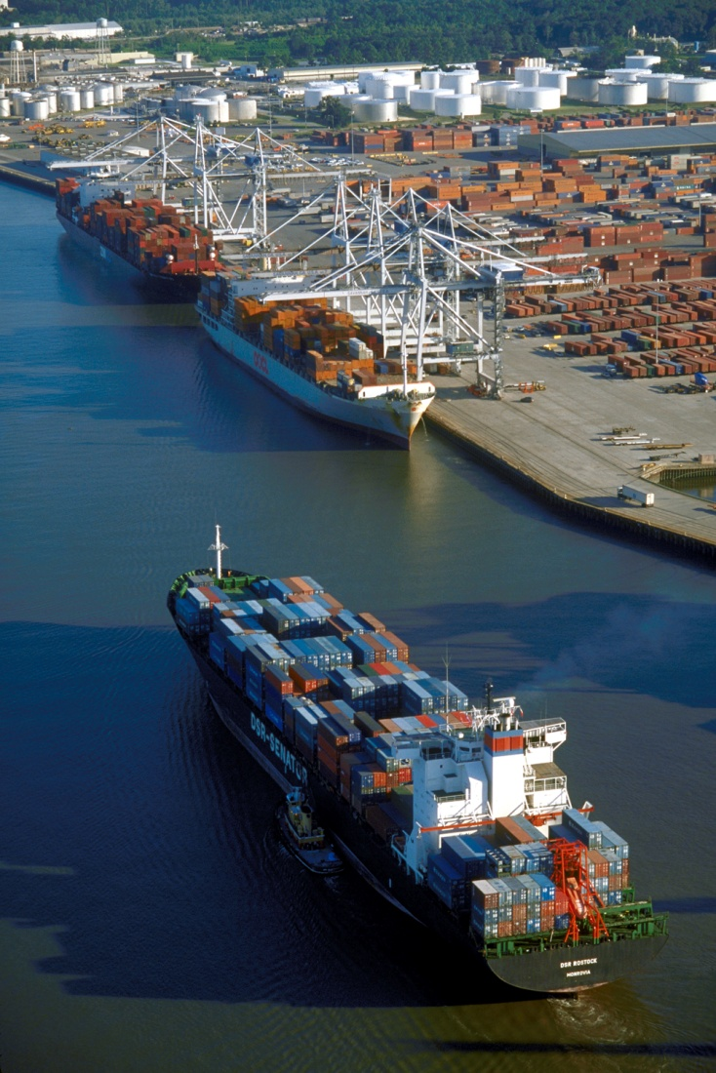
Port Characteristics
Terminals
Berthing Dimensions
Terminal Capacities
Port Institutions
Master Plan
Data source - Port Series
Notes:
Port information provides the basis for identifying constraints, identifying opportunities, and defining problems. It serves as a yardstick of what the local interests have done and can do. Because most projects involve channel enlargement to accommodate more capacity per ship and usually larger ships as well, you have to see what constraints berthing areas may have on channel enlargement. Also, do the terminals have the throughput and storage capacity to accommodate the larger ships? Is there room for longer ships to turn around? If you deepen the channel, do the berthing facilities also need to be deepened? And you might shock the sponsor with this one–is there an option of moving a facility seaward instead of enlarging the channel?
One potential source of information about port facilities is the Corps’ Port Series, produced by IWR. The Port Series is a map and statistical compilation of the port setting that lists all the terminals, their handling capacity and a description of their berths, including depths. If berthing depths are less than the authorized channel depths, you know that the ships calling at that terminal do not now need the existing channel depth, and thus, those that would call in the future would also be unlikely to benefit from proposed deepening.

Slide 31
Characteristics for Commodities Affected by Delays/Capacity
Commodity movement
  Commodity categories
  Origin/Destination
  Annual volume
  Inland modes involved
Alternative mode information
Trading patterns
Notes:
Cargo information is used for an initial determination of the economic study area, and to provide the basis for commodity flow projections or forecasts. The information needed includes the size and composition of cargoes (annual tonnage by commodity or commodity categories), the origins and destinations of the cargoes (inland or hinterland, and external), and the inland transportation modes. Vessel information, which we will discuss in a moment, will help you identify the relevant traffic. Focusing on the commodities that potentially produce benefits will save time and effort, even though the initial short list may need modification later.

Slide 32
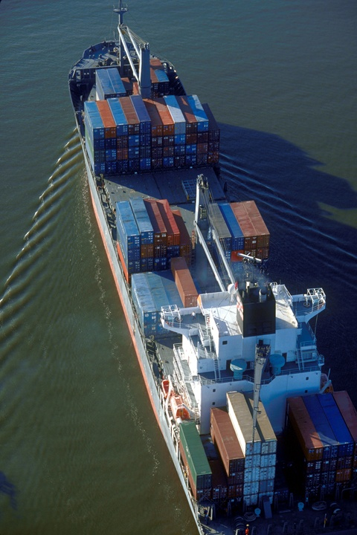
Vessel Information
Port vessel fleet
Vessel size data
Vessel operating drafts
  limited by general navigation features
  design versus operating
Vessel capacity utilization
Light loading analysis
Vessel itinerary
Vessel operating costs
Changing legal requirements
Notes:
Vessel information is used in the analysis to determine future port fleet composition, and to identify how vessels operate at the project port. The information needed for fleet analysis includes the size distribution and capacity utilization of the present port fleet, and the limits on vessel sizes due to channel constraints at the project port and elsewhere on the vessel’s itineraries. The data that best identify capacity utilization and channel constraints are the actual drafts of the vessels, and their maximum loaded drafts.
It is preferable to have a minimum of one year of record for all commercial vessel calls to identify fleet composition. Theoretically, sampling should suffice when the port under study has a large number of vessel movements. An alternative is to focus on the types and sizes of vessels that are or will be impacted by channel constraints, and obtain information on all of those vessels. However, the portion of the fleet not directly impacted in terms of waterway operating constraints is also of importance due to the share of tonnage throughput allocated to this segment of traffic relative to facility handling capacities, potential waterway congestion and reconciliation of fleet and cargo throughput forecasts. In addition, with computerized data (if available), sampling should only be applied when and to the extent that time and budgetary constraints mandate.
Vessel Size Data
This data will allow the planner to know more about the nature of the fleet currently using a port and to plan what the fleet characteristics of the future fleets could be. The usual source for ship information is Lloyd’s – Fairplay. Institute for Water Resources (IWR) is a subscriber of ship characteristic data, and that information is available to you through IWR. Primary sources of data also include Clarkson’s Research Services. Jane’s Research is another source of vessel characteristic data, for both commercial cargo and military vessels, while the Corps WCSC publishes some information on vessels in domestic service or of U.S. registry.
Vessel Capacity Utilization: Generalized values for use in making adjustments to vessel capacity needed to calculate transportation costs are shown in Table 10-6 of the IWR NED Manual for Deep Draft Navigation. The “representative” values do not reflect extreme variations in real life, but may be useful to get a ballpark idea on some vessels.
Light loading: The practice of loading a vessel to less than its design draft to accommodate channel constraints.
Vessel itinerary: The economist should determine the port and vessel deployment patterns that account for the distribution of sizes of vessels calling
under the existing conditions. Deployment assignment of a vessel to functional service, such as a route. Usually vessels are assigned to routes or geographic deployments reflective of liner and charter operations. Once this is done, it can be expanded to forecast the without-project condition.
Vessel Operating Costs: The Institute for Water Resources develops vessel operating costs which are approved by Headquarters and published as an
Economic Guidance Memorandum (EGM) every two years. The EGM includes vessel operating costs for certain common vessel types, but the PGN allows
license to develop port-specific vessel costs.
Changing legal requirements—e.g., double hulled vessels (Oil Pollution Act of 1990)

Slide 33
Lightering
Notes:
33 C.F.R. Subpart B—Special Requirements for Lightering of Oil and Hazardous Material Cargoes
Lightering or Lightering operation means the transfer of a cargo of oil or a hazardous material in bulk from one vessel to another, including all phases of the operation from the beginning of the mooring operation to the departure of the service vessel from the vessel to be lightered, except when that cargo is intended only for use as fuel or lubricant aboard the receiving vessel.
• Gulf of Mexico
o used for full discharge of very large tankers
o used routinely to lighten tankers offshore
o performed by “small” tankers, usually 25,000 to 50,000 DWT, foreign flag
o Cost of delay time for lightered vessel
• New York Harbor, Delaware Bay, San Francisco Bay
o Used routinely to lighten tankers offshore
o Performed with barges
• Lower Mississippi
o A variant called “midstreaming” (meaning ship to ship
movements) used to load coal vessels directly from river barges

Slide 34
Forecast of Fleet Mix – 2 Components
World fleet mix
  Commercially available by industrial experts
  Needs to be disaggregated to the port level
Port fleet projections
  Trend analysis – Need to ensure that ships are available which could be going to other ports/trade routes
  Distribution accounting - Need a wide enough distribution of vessel sizes in the fleet mix
Notes:
One Size does not fit all. As a cautionary note, the actual distribution of vessel sizes at a port is unlikely to resemble the distribution of vessel sizes in the world fleet. The actual range will be limited on the upper end by channel size, and on the lower end by the higher cost of transportation in smaller vessel sizes. Within the actual range, the distribution of sizes of sizes will reflect a combination of factors more-or-less unique to each port. The actual size range for a port can be determined from statistics, and the upper end can be estimated with reasonable accuracy based on channel depths, indicating the use of tides, and maximum light loading that provides competitive costs. The port’s upper and lower size limits can be used to produce a size distribution useful for certain purposes. You have to beware to avoid double counting the most efficient ships at competing ports. To minimize this potential you can apply a proportional share of the world’s fleet.
After you have predicted what commodities will move through the port in the future, you have to predict how these commodities will move through. In other words, what subset of the world fleet will service these commodities? The extent to which the port fleet composition will change because of the project will depend on the availability of larger and/or more efficient vessels and the ability of harbor users to employ them. Rudimentary fleet forecasts can be derived from basic extrapolation of existing fleet service patterns and information. With regard to commercial fleet forecasts, world-level forecasts (often benchmarked to deadweight capacity) of fleet structure are available. These world-level forecasts must be disaggregated to the project level. This is perhaps one of the most difficult tasks to perform. Nonetheless, an acceptable or rudimentary forecast can be assembled with diligent efforts to gather data and perform interviews with vessel and facility operators, but as with commodity projections, for large, costly or controversial projects, or projects where justification or formulation is sensitive to relatively minor changes in projected fleet activity or throughput, it may be advisable to seek support from industry forecast specialists.
The next few slides will give you a feel vessel size trends.

Slide 35
Distribution of Design Draft and TEU Capacity
Notes:
Distribution of Design Draft and TEU Capacity, shows the variability of the relationship between containership design draft and carrying capacity. The relationship of the future fleet and benefits is dependent, to a large extent, on their draft and carrying capacity.
Notice that some vessels have the same capacity yet have different design drafts.

Slide 36
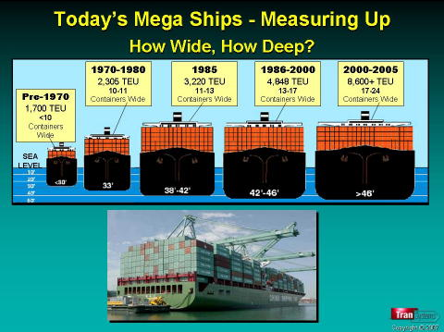
Notes:
One of the mainstays of international transport, container lines have constantly upped the ante by building ever-larger ships to improve efficiency. As recently as 2000, the largest container ships in service had a capacity of 6,600 TEU (standard shipping containers), but on 30 April 2003, Hong Kong-based Orient Overseas Container Line (OOCL) launched the largest container ship ever.
With a registered capacity of 8,063 Twenty-foot Equivalent Units (TEU), the 322.97-m (1,059.61-ft) long OOCL SX-class vessels are the world's largest container ships. The first, OOCL Shenzhen, was launched on April 30, 2003. It was built by Samsung Heavy Industries Co., Ltd (South Korea), and is owned and operated by Orient Overseas Container Line Ltd (OOCL). OOCL Shenzhen is the first in a fleet of SX-class vessels which are to be delivered by the end of 2005. Other specifications include:
Beam: 42.8 m (140.4 ft)
Draft: 14.5 meters (47.6 feet)
Deadweight: approx. 100,000 tonnes (cargo-carrying capacity)
Full load speed: 25.2 knots (46.6 km/h or 28.9 mph)

Slide 37
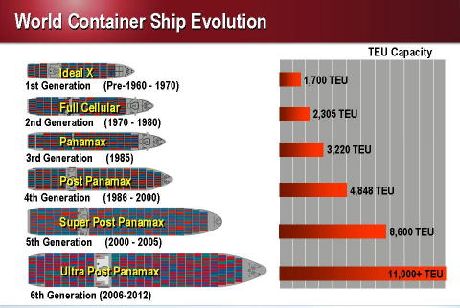

Slide 38
Large Containership Depth Requirements
Notes:
This Slide is an example of the characteristics of the future “design” ship. It addresses both expected operating drafts and the underkeel requirements.

Slide 39
What Next – 18,000 TEU
Mearsk Triple E Class
400 m long
59 m wide
2 engines, top speed 23 knots
Designed to sail Europe to Asia
Largest vessel of any type known to be in operation

Slide 40
Large Containership Depth Requirements
Notes:
This Slide is an example of the characteristics of the future “design” ship. It addresses both expected operating drafts and the underkeel requirements.

Slide 41
Existing Annual Transportation Costs
Ship operating costs
Origin-to-destination costs
  Transit costs
  Delay costs
Landside/Port costs
Notes:
Ship operating costs. To determine the existing annual delay/capacity costs, you have to start with ship operating costs. There are three components: the replacement or financial costs, fuel, and fixed operating costs. IWR is charged with producing vessel-operating costs.
Origin-to-destination costs. Analysis calls for the current transportation costs in NED evaluation, and those costs are to include the full origin-to-destination costs including necessary handling, transfer, storage, and other accessorial charges. For both theoretical and practical reasons it is necessary to interpret just what costs are costs, and whether all of those costs have to be counted in evaluation. The emphasis, of course, is on the transportation costs.

Slide 42
Commodity Forecasts
By type
By volume
By origin and destination
By transportation mode
Consult with IWR
Notes:
This process involves identifying both future commodity movements and hinterlands. Commodity projections begin with current and relevant historical baseline data. The objective is to identify the volume of benefited traffic. By far the easiest exercise, relatively speaking, involves a harbor that improvements would only apply to one commodity, especially if that were an import.

Slide 43
Topics to be Discussed
Basic Concepts
Problem Identification
Inventory and Forecast
Determination of Objectives and Constraints

Slide 44
Planning Objectives
Properties of objectives
  Flexible - Accommodate alternative ways to achieve
  Measurable – not nebulous
  Attainable
  Congruent – not rule out other objectives
Avoid specifically seeking the solution
Notes:
Planning objectives are the things we want to accomplish with a plan and generally are suggested by the problem statements. They are the desired changes between the without- and with-project conditions. Objectives should be flexible enough to accommodate alternative ways for achieving them as well as to allow alternative levels of results. There should be measurability. To be measurable an objective must be stated in terms that can be assessed or quantified. Finally, objectives will be congruent with each other. Congruency means the objectives fit together. More specifically, attainment of one objective would not preclude the attainment of another.
What planning objectives should not do is state the solution or Federal objective.

Slide 45
Planning Objectives
Sabine-Neches Waterway Feasibility Study
Improve the navigational efficiency along the waterway
Maintain the ecological values of coastal and estuarine resources within the project area
Notes:
You have to develop the objectives that should be articulated in a clear statement of the study purpose along with what an alternative should try to achieve. It should be obvious that the objectives need to be attainable. The objective statement should be such that can accommodate different alternatives which do not rule out other alternatives. Finally there should be measurability. What it should not do is state the solution or Federal objective. An example of what not to do is to have an objective statement such as “the project should provide a 50-foot channel.” Instead it could be something like “the project should accommodate larger ships in certain interior channels (cite them) within the next five years.

Slide 46
Planning Objectives
Port of Iberia, Louisiana
Develop the most effective plan for providing deep draft access to the POI from the Gulf of Mexico.
Use dredge material to beneficially restore bank line and create marsh.

Slide 47
Planning Objectives
Corpus Christi Ship Channel, Texas
To improve the efficiency and safety of the deep-draft navigation system, and
To maintain or enhance the quality of the area’s coastal and estuarine resources.

Slide 48
Planning Objectives
Miami Harbor, Florida GRR
Determine if sufficient light loading, tidal delay, or other commercial navigation benefits exist to deepen the Federal system of channels from existing project depths of 42 and 44 feet to depths of 50 and 52 feet;
Evaluate components which would reduce the impact of variable and unpredictable crosscurrents in the area of buoy 1 at the beginning of the entrance channel and at the Fisher Island turning basin where three channels converge;
Examine components to reduce or eliminate the surge effect on ships docked at the Lummus Island terminals from other passing ships in Fisherman’s channel;
Determine if the proposed components meet the needs of future commercial ship navigation requirements;
Identify environmental and cultural resources in the study area and potential impacts from deepening or widening to those resources;
Review the impact of proposed components on the existing harbor maintenance and future dredged material management plans; and
Identify the NED plan for Miami Harbor, which most efficiently and safely accommodates larger vessels while preserving natural and recreational resources.

Slide 49
Planning Objectives
Boston Harbor Feasibility Study
Contribute to National Economic Development by minimizing the cost of transporting existing cargo volumes and anticipated future increases in cargo volumes to and from New England in an environmentally acceptable and sustainable manner during the 2014 to 2064 period of analysis.
Reduce current and expected future tidal delays for the existing and anticipated future fleet of container and bulk cargo vessels calling at Boston Harbor during the 2014 to 2064 period of analysis by examining improvements to channel, anchorage and turning basin dimensions and local berths and facilities.
Reduced current and expected future light loading requirements for vessels calling at Boston Harbor during the 2014 to 2064 period of analysis by examining improvements to the harbors general navigation features and local service facilities.

Slide 50
Planning Objectives
Boston Harbor
(continued)
Reduce current lightering requirements and potential future increases in lightering for petroleum tank ships calling at Boston Harbor during the 2014 to 2064 period of analysis by examining improvements to channel dimensions in the Chelsea River.
Maximize the beneficial use of dredged material for habitat creation and other purposes during the 2014 to 2064 period of analysis covering initial construction and future maintenance of the project.
Consider all the previously identified opportunities in the formulation and evaluation of alternative plans, and recommend the preferred means of achieving the above-listed objectives, consistent with the Federal interest as set forth in the Principles and Guidelines, during the 2014 to 2064 period of analysis.

